Slide 1
Personal Development
Personal Grooming

Slide 2



Agenda
How to dress up in formal, informal occasions?

Slide 3

HOW TO DRESS UP IN FORMAL, FORMAL OCCASIONS
UNIT # 8.1

Slide 4
What is grooming?
It is the process of making yourself
look neat & attractive
The things which you do to make yourself and your appearance tidy & pleasant

Slide 5
How To Dress For An Interview - How to Dress to Impress

Slide 6
80% percent of communication is non-verbal according to the Protocol School of Washington, and this includes messages telegraphed with your wardrobe.
Before you get a chance to say hello, what you wear on an interview or a meeting speaks volumes about your personality and level of professionalism.

Slide 7
Grooming - Man

Slide 8
SHIRTS
“As a rule, the simpler the better”
Colour: White, off white, pale, blue shirts are preferred;
though you may wear dark colored shirts too.

Slide 9
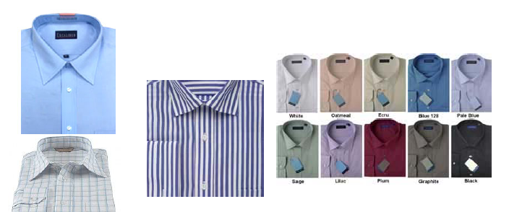

Slide 10
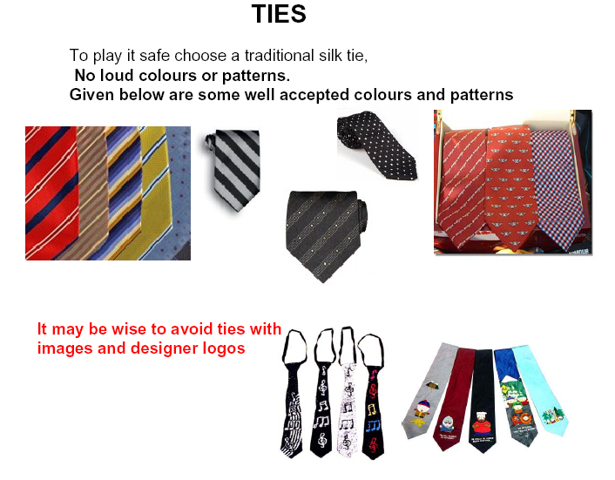

Slide 11
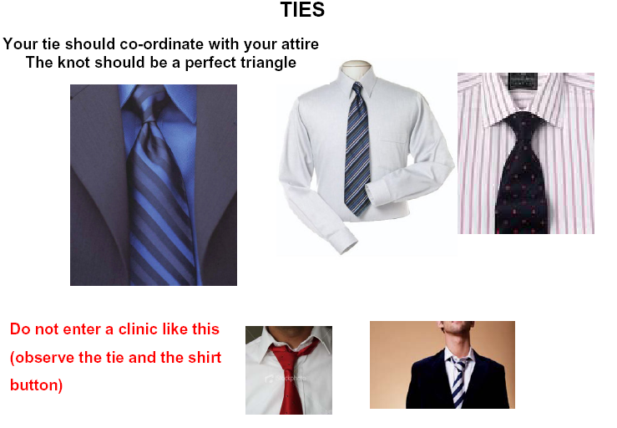

Slide 12
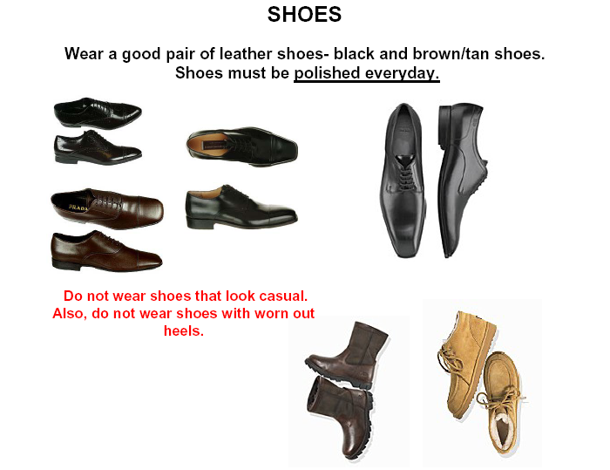

Slide 13
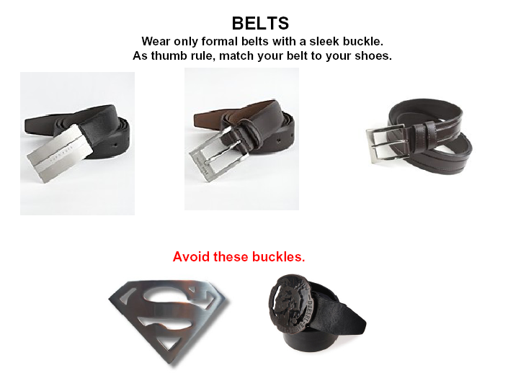

Slide 14
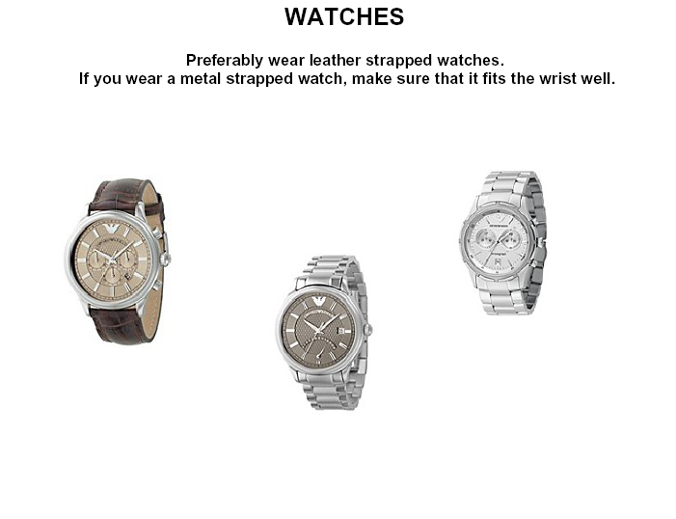

Slide 15
GROOMING - WOMEN

Slide 16
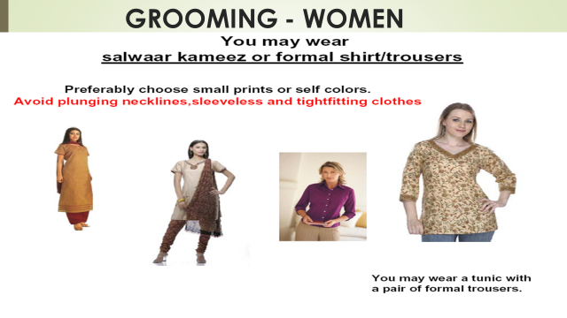
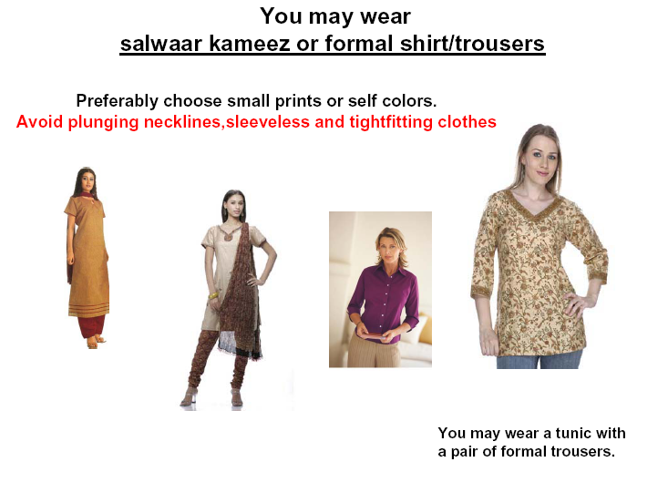

Slide 17
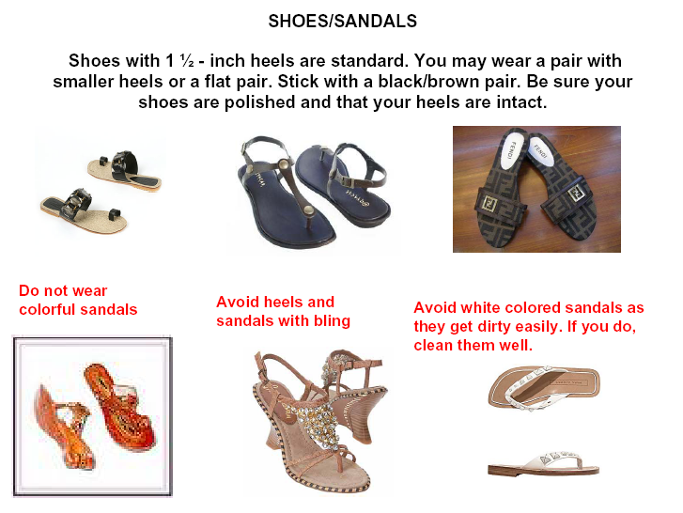

Slide 18
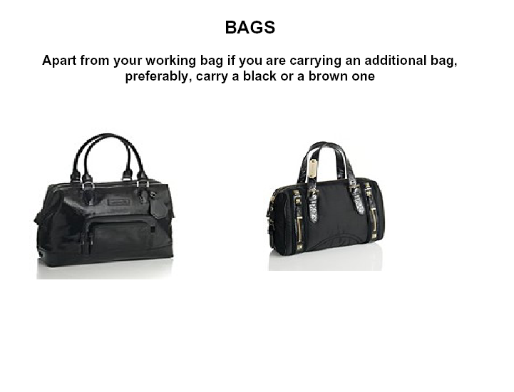

Slide 19
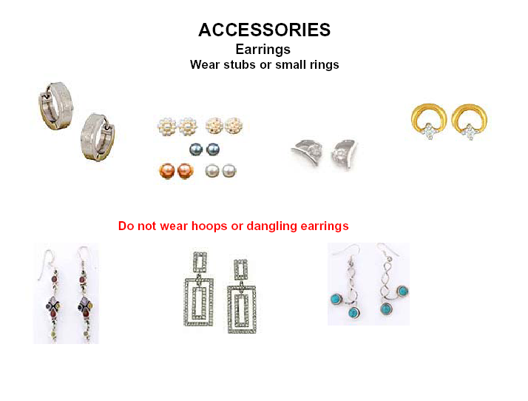

Slide 20
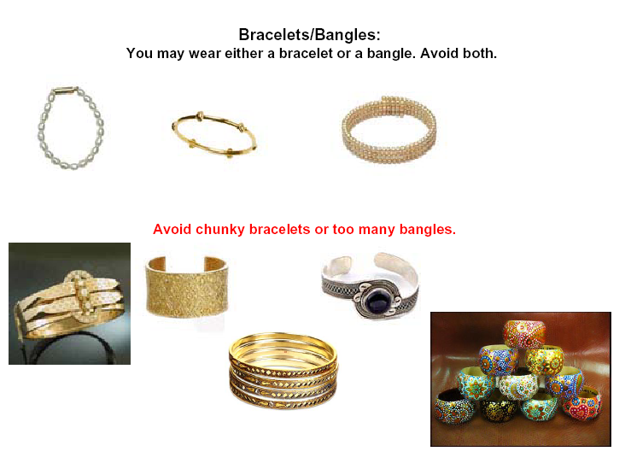

Slide 21

HOW TO DRESS UP AS A STUDENT
UNIT # 8.2

Slide 22
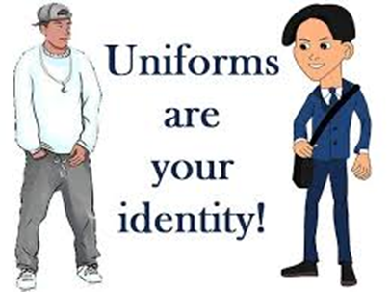

Slide 23

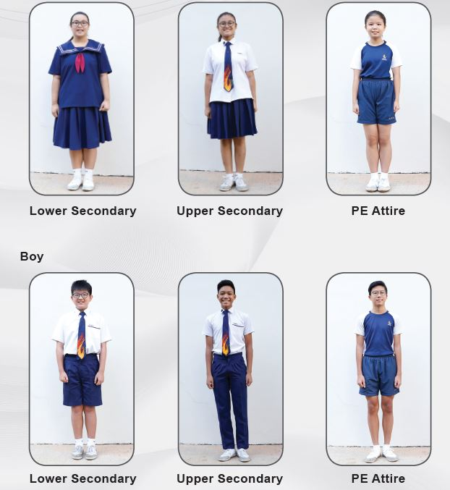

Slide 24
WHY GOOD ETIQUETTE AND WHY GOOD MANERISM
UNIT # 8.3

Slide 25

What is Etiquette
Etiquette is a French word that means a “label” or “ticket.”
These are practices and forms prescribed by social convention or by authority.

Slide 26
What is Business Etiquette?
Etiquette is a set of unwritten rules that apply to social, professional workplace relationships
Office etiquette is about conducting yourself respectfully and courteously in workplace.
In the business world, good business etiquette means that you act professionally and exercise proper manners when engaging with others in your profession.

Slide 27
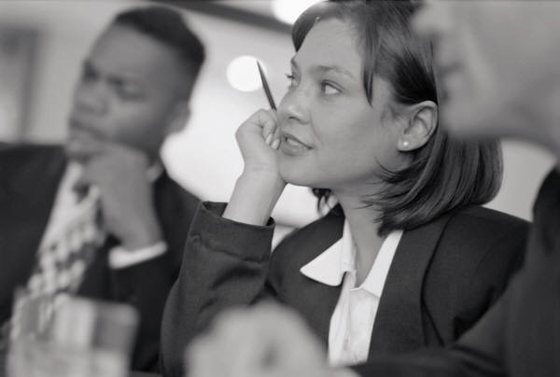
Business Meeting Etiquette
Host should send a planned agenda ahead of time with clear objectives.
Start and stop on time. Don’t wait for latecomers.
Always have your calendar, notebook, and pen.
Meetings should be focused on topics related to overall strategies.
Avoid “you” talk. Always have “We” attitude
Allow all participants to be involved. Encourage participation.

Slide 28
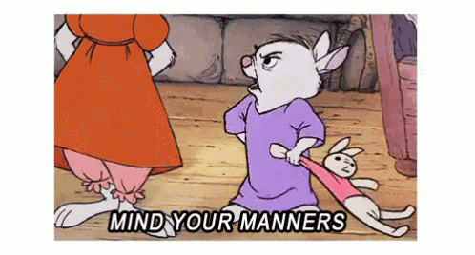
In Conclusion, Why Good Mannerism?
Manners and etiquette will make the difference in whether you get that customer, a promotion, or that first job!
Business etiquette is simply about feeling and showing kindness and respect for those around you. It is about exercising good judgment.

Slide 29
INTERVIEW SUCCESS
UNIT # 8.4

Slide 30
Dressing for an Interview:
You should wear a suit to interviews. “Suit” means the works: a matching jacket and pants, dress shirt, tie, coordinating socks and dress shoes. A dark- colored suit with light colored shirt is your best option.
Your suit should be comfortable and fit you well so that you look and act your best.
Avoid loud colors and flashy ties

Slide 31
“There is no accomplishment so easy to acquire as politeness, and none more profitable” -George Bernard Shaw

Slide 32
